Slide 1

SYSTEM SURVEILLANCE using KEYLOGGER
NISHIKANT–08013202720
NITIN- 08113202720
PRABHJOT SINGH-08513202720
PRABHJOT SINGH JAGGI-08613202720

Slide 2

Objectives…..
Define Key logger
Captures keystrokes
Sends mail to the admin
Monitors the system
activities by others

Slide 3
CONTENTS…..
What is keylogging ?
Importance of keylogger
Features of keylogger
Pro- Features of keylogger
Program files
Modules used
Keylogger Architecture
Programming
Block diagram
System Requirement
Conclusion

Slide 4

What is Keylogging ?
A program or Hardware device that capture
every key impression on the system.
Used to monitor user’s activities .
Used to retrieve data and forgotten URLs .

Slide 5

Importance of Key logger …
IT organizations can indicate their concerns by going after the culprit whose performance is deteriorating that of the whole organization .
Keylogger s/w is also available for use on smart phones, such as iPhones and Android .

Slide 6
FEATURES OF KEYLOGGER
Key stroke
monitoring
Web site visited
Screen shot capturing
Windows startup
Program captured
Startup Alert

Slide 7
Pro-Features of Key logger
Log exporting
Remote viewing email delivery
Log Filtering
Optimal stealth
mode
Customizable
Setting mode
Auto log clearing

Slide 8
execute_keylogger.py
Program files :
Keylogger.py

Slide 9
1 -SMTPlib :
It is a client session object that can be used to send mail to any internet machine with SMTP domain
2 -Pynput :
This library allow you to control and monitor input devices .
ModuleUsed :
3 -Keylogger :
Surveillance technology used to monitor or record each key stroke
4 -Threading :
It used to run certain code / processing in background and without consent of user

Slide 10
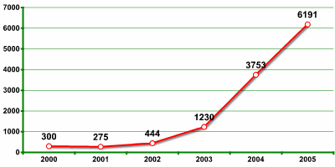
Key logging functionality of one company in Verisign’s recent report as rapid growth in malicious program

Slide 11
Ke
Key Logger Architecture
Application
Internet Explorer
FTP module
Application
Hook procedure
Hook procedure
Hook procedure
Main Module

Slide 12
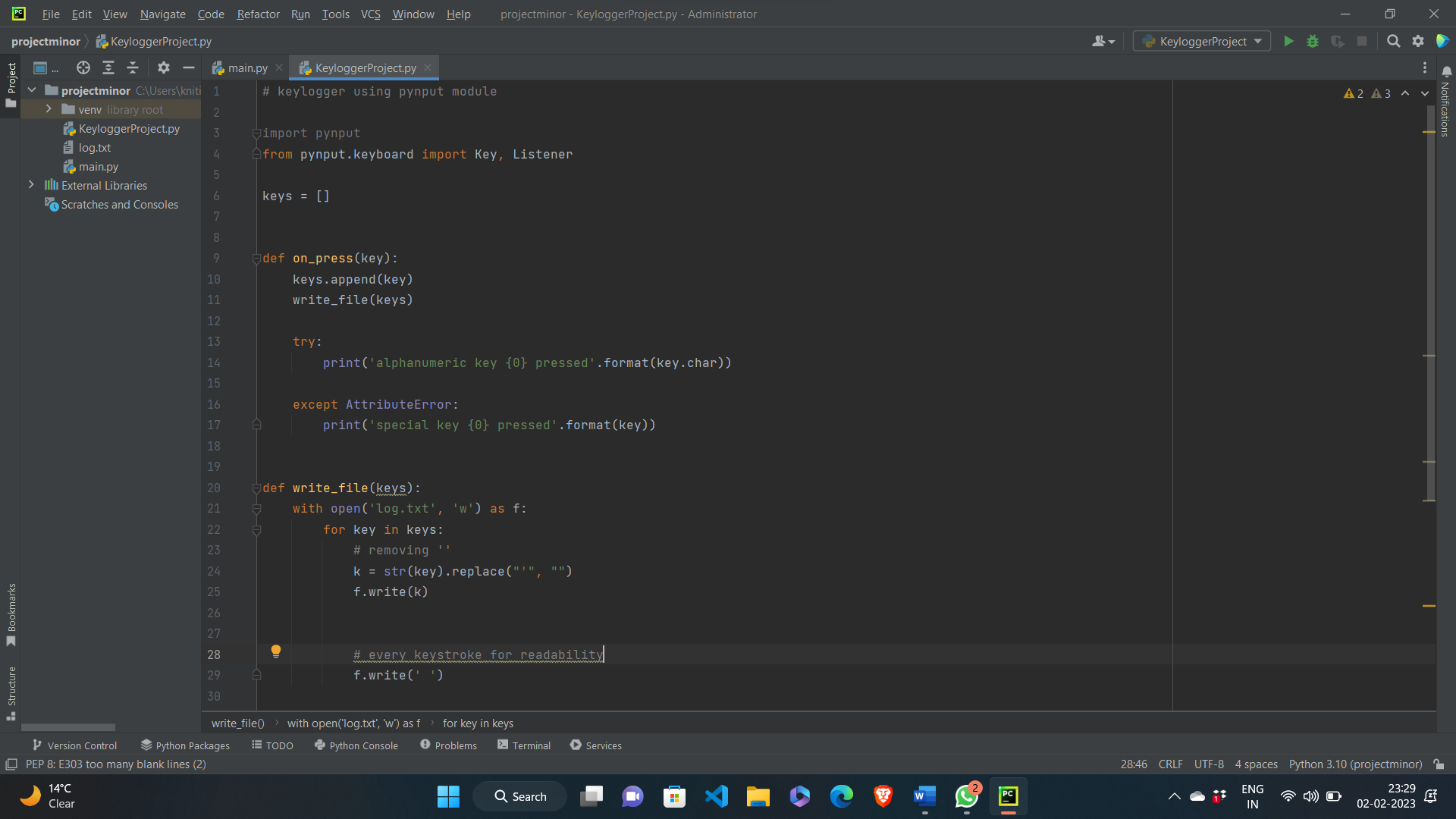

Slide 13
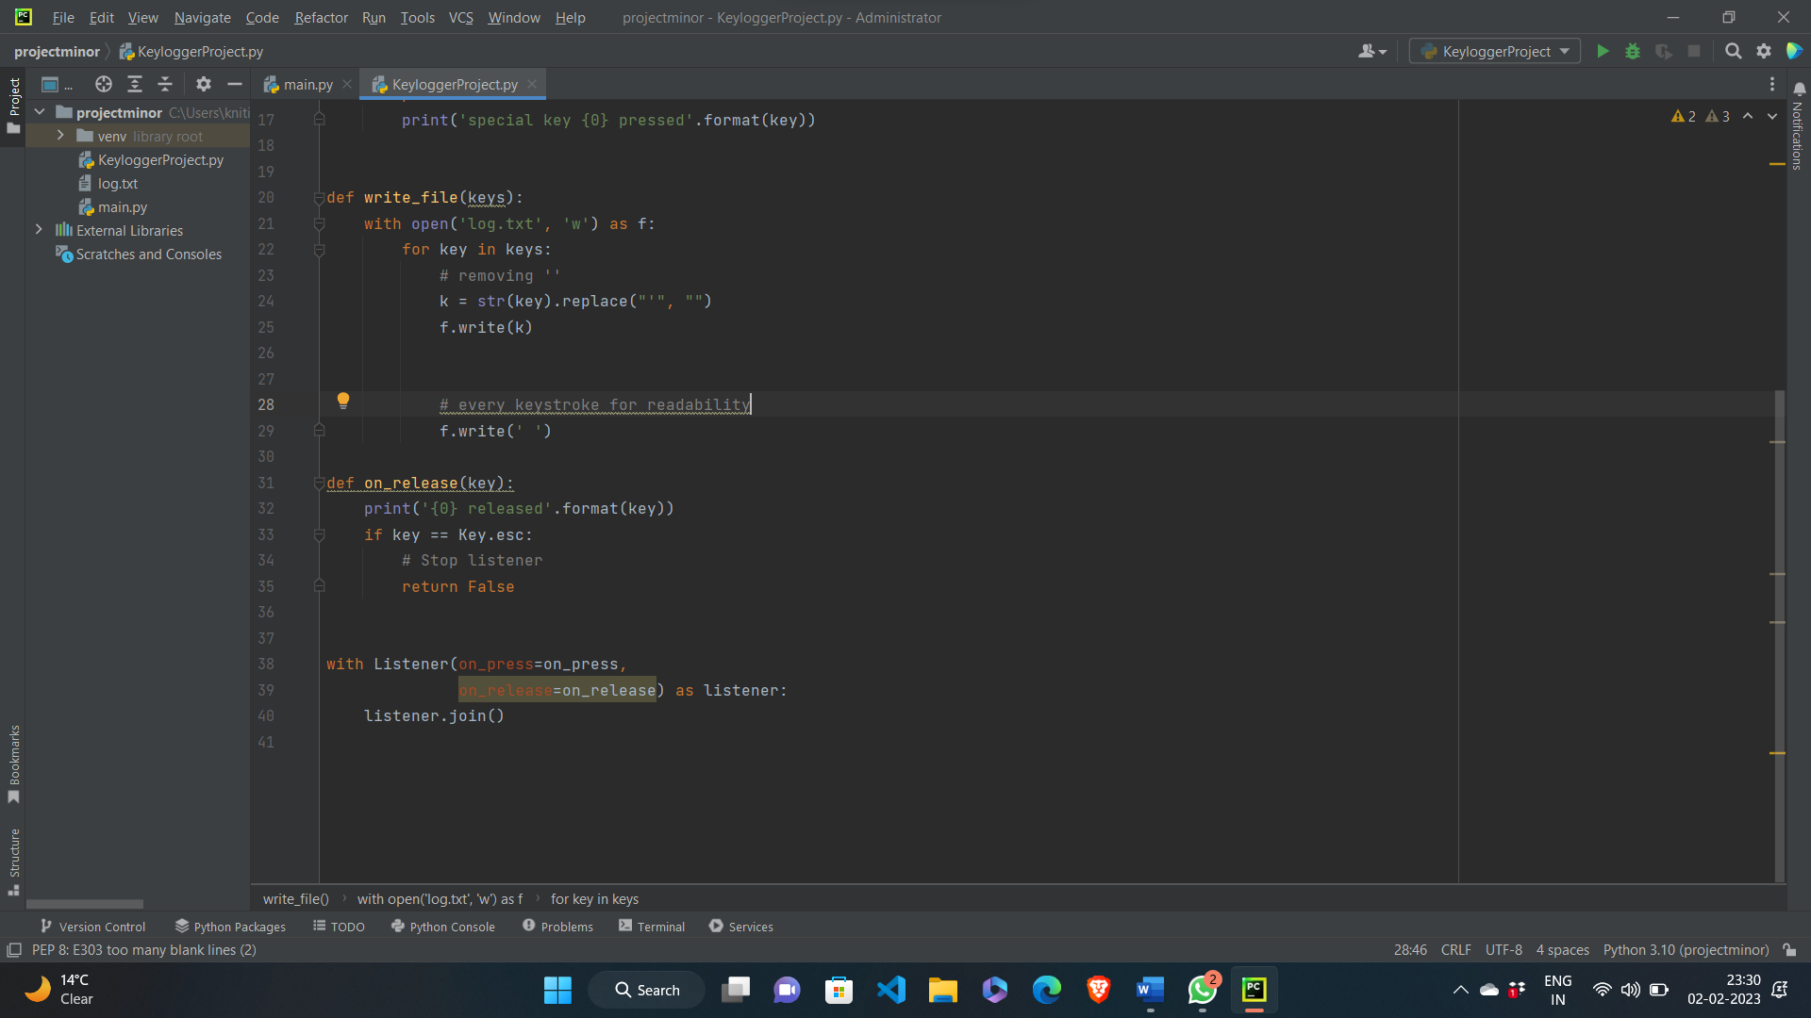

Slide 14
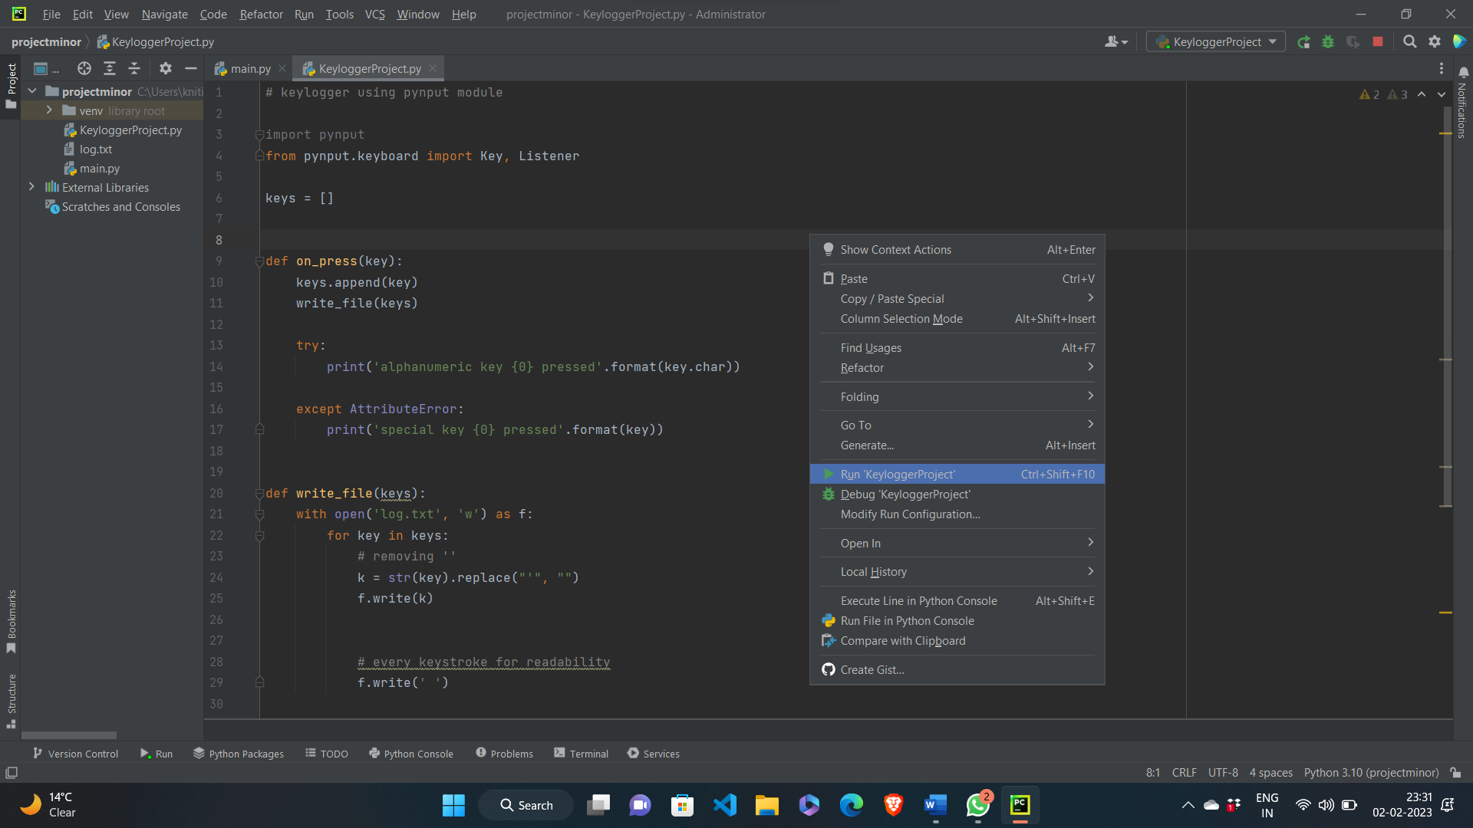

Slide 15
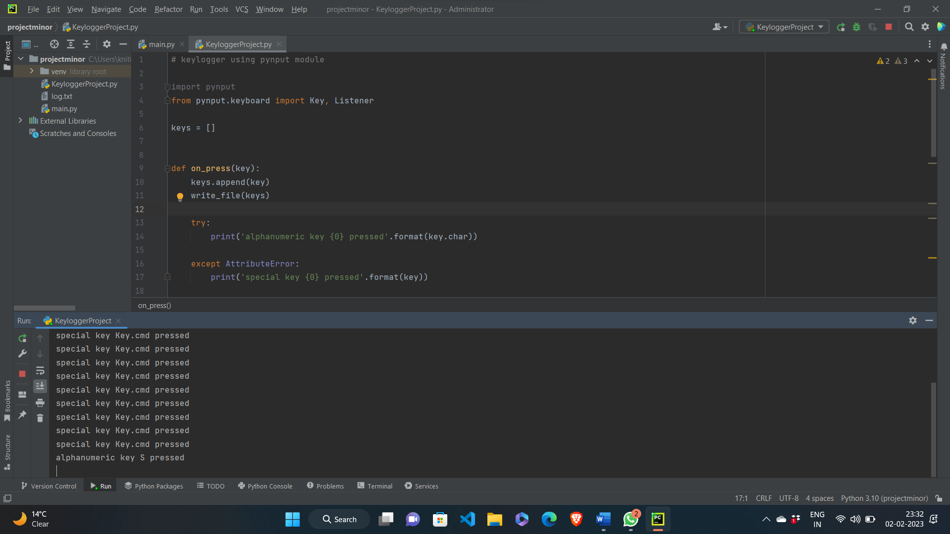

Slide 16
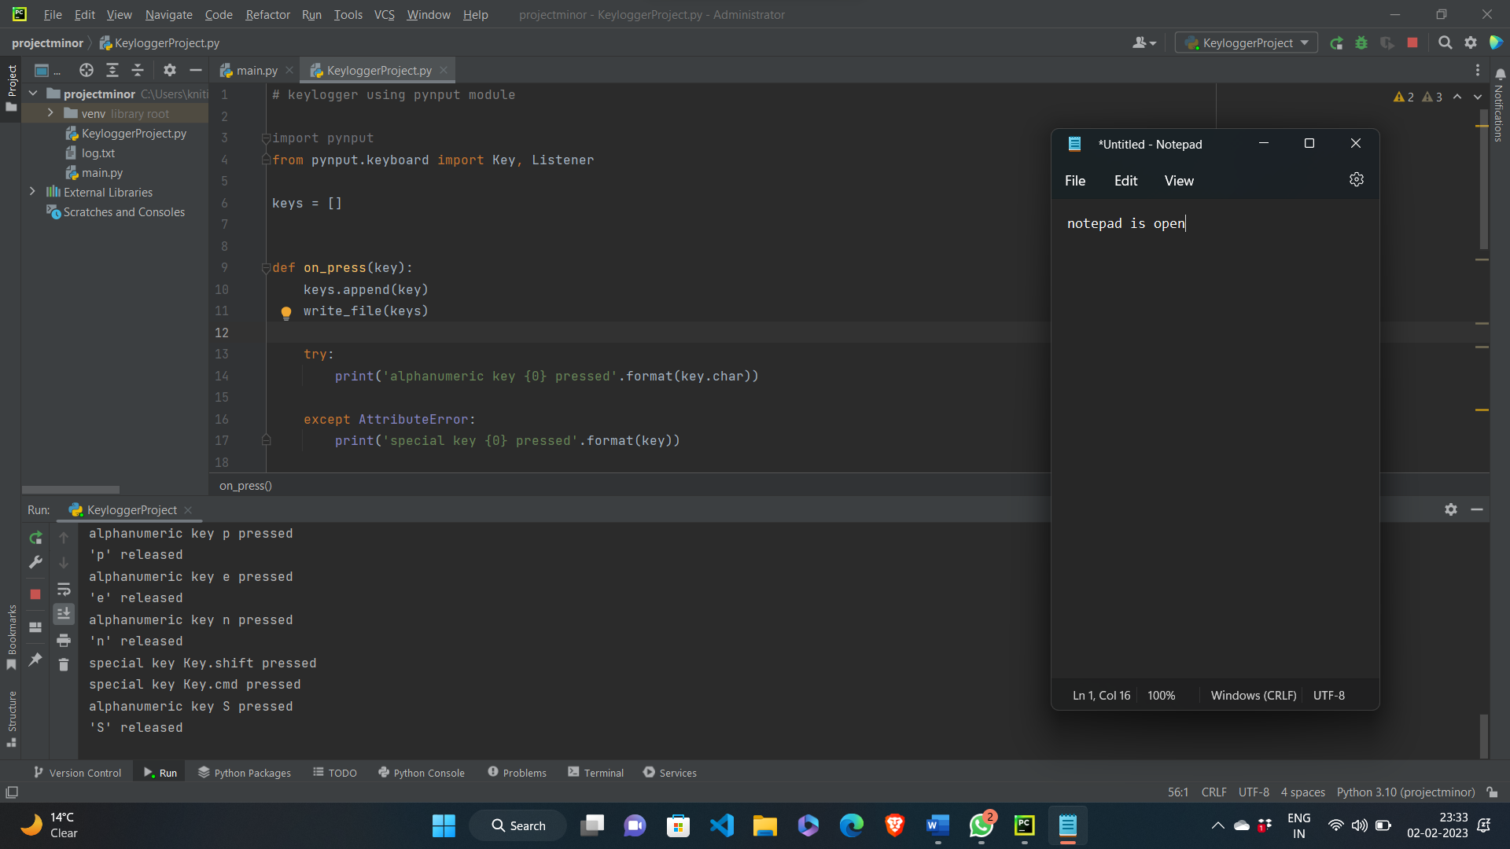

Slide 17
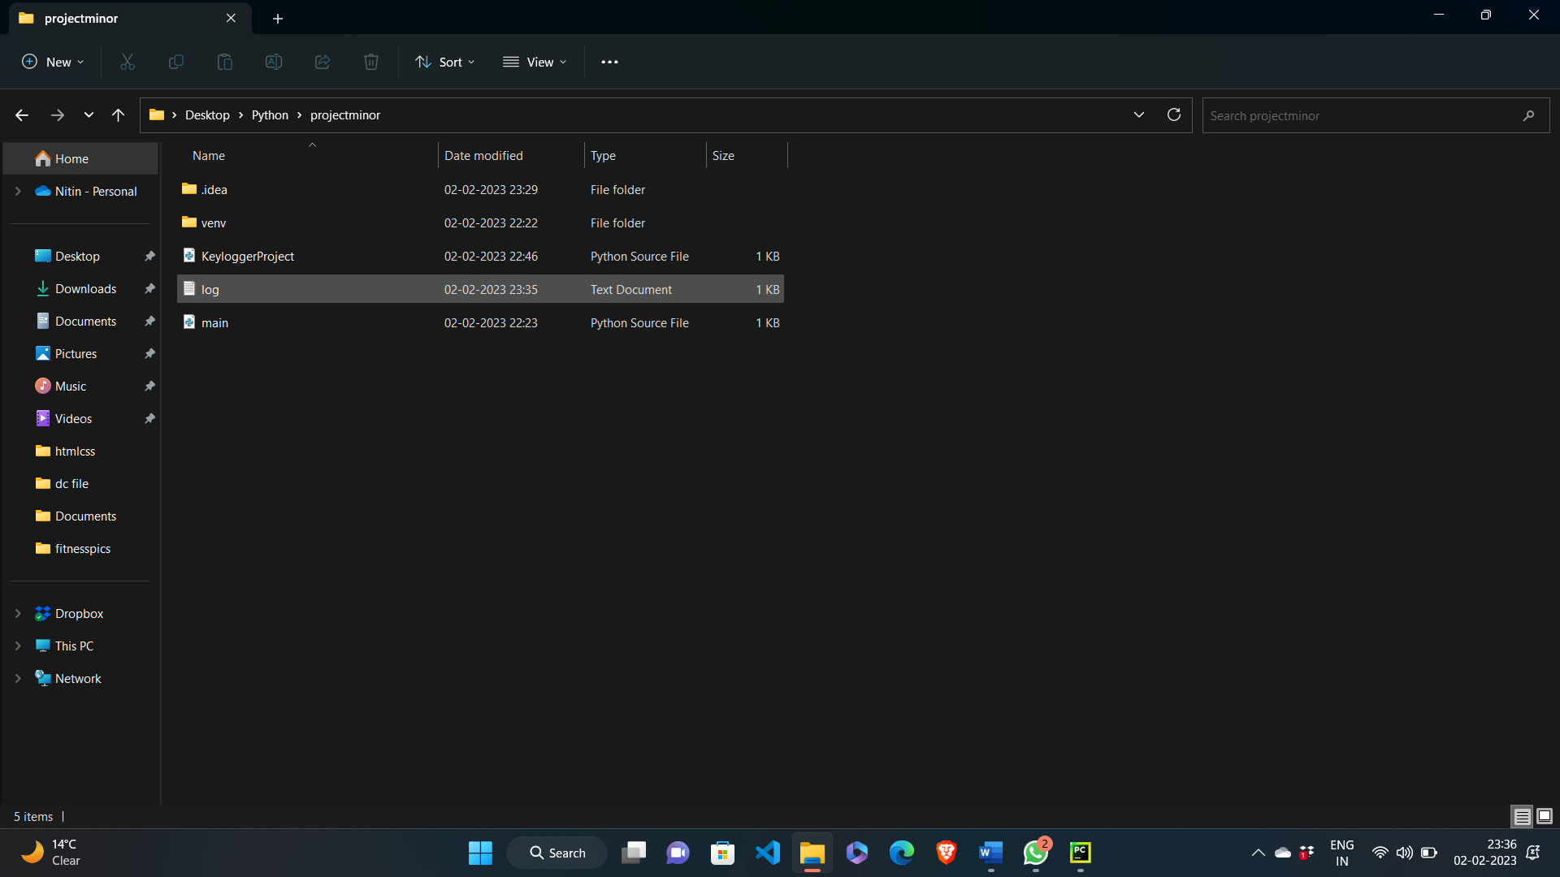

Slide 18
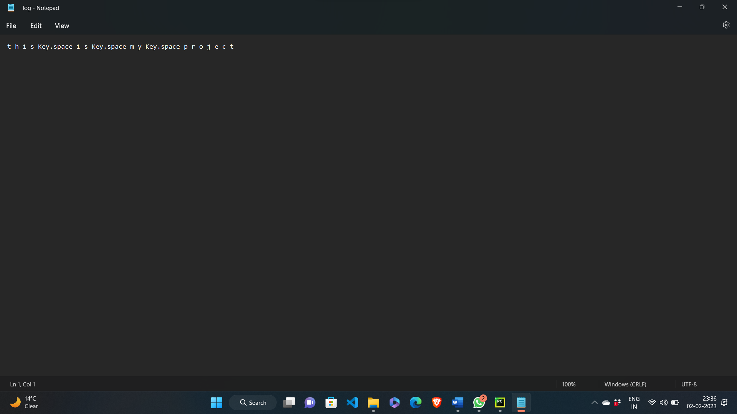

Slide 19
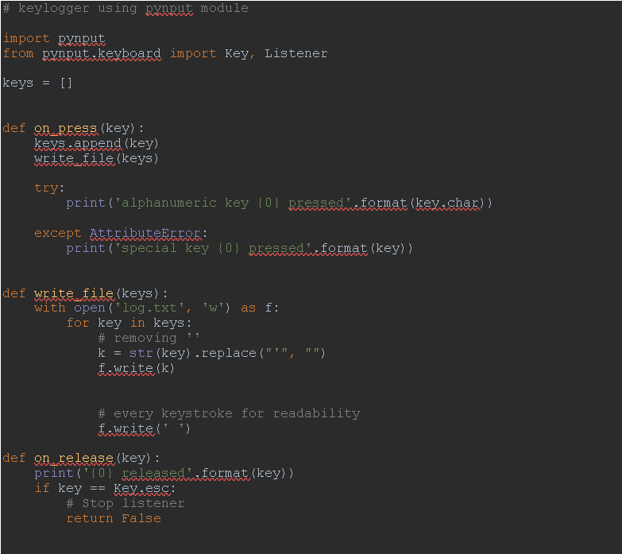

Slide 20
Spyrix Keylogger
Actual Keylogger
Examples of Keylogger
Revealer Keylogger
REFOG Keylogger

Slide 21
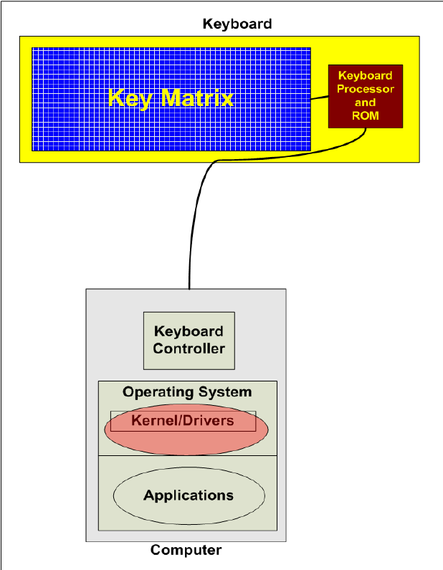
Block diagram

Slide 22
System requirements
Windows 2000, Windows XP (32-bit and x64), Windows Server 2003/2008, Windows Vista (32-bit and x64), Windows 7, Windows 8 (32-bit and x64); Windows 10 ,
Windows 2000 or later ,
Internet Explorer 5.0 or later ,monitor : 15” colour ,HDD 40GB
Basic input devices required: keyboard
Basic output devices required: mobile devices
S/W requirement: PyCharm, Python 3.8.0
Technologies used: Advanced programming using Python

Slide 23
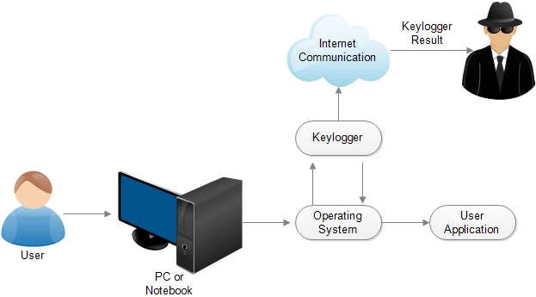
Keylogger process in user activity

Slide 24
CONCLUSION :
Key logger record keystrokes
Legitimate use : monitor employee activity
legal uses : steal password , user name and other personal / corporate data . Reports show that there is an increased tendency to use rootkit technologies in keylogging software, to help the keylogger evade manual detection and detection by antivirus solutions.
Only dedicated protection can detect that a keylogger is being used for spy purposes.
Be conscious what installed in the computer.
Use caution when snuffing the internet.
Keep your computer software update.

Slide 25

THANKS !!!

